Slide 1


Customer Quote Application with MySQL
- Deana Briggs -

Slide 2


Add a Customer
CASE 1:
Insert the entered information into “customer” and “address” tables unless they exist and start a “new project”
Enter Customer Information
First Name
First Name
Last Name
Last Name
Address
Address
City
City
State
State
Zip
Zip
Email
Email
Phone
Phone
Business
Business (if applicable)
Add Customer

Slide 3
Build a Quote
CASE 2:
Provide a filtered list of products based on “Brand” and “Category”
Select Quote Options
Customer:
John Smith
CASE 3:
Store selected products with quantity in a temporary table
ID: 1111
Option Title:
HIK 4 Camera System
Brand:
HIK / AXIS / ADC
Category:
Quantity:
Product:
Camera
Product
1
Camera
Recorder
Hard Drive
Accessory
4MP Turret
8MP Panoramic
Doorbell
Mini-Dome
PTZ 4x
PTZ 16x
LPR
CASE 4:
After products are selected create the quote and store selected products
Calculate

Slide 4
Calculate Quote
CASE 5:
Calculate and updates the database with the values to populate the views
CASE 6:
Deletes the quote if a manager rejects it or update to approved if approved
Review and Approve
Manager View
Agent View
John Smith
Customer View
ID: 1111
HIK 4 Camera System
HIK 4 Camera System
HIK 4 Camera System
Charge Customer
$1600
CASE 7:
Updates the project status when the customer accepts or declines the quote
Estimated Hours
8
Estimated Hours
8
Estimated Hours
8
Total Charge
$1600
Total Cost
$1200
Labor:
$300
Total Charge
$1600
Commission
$300
Comm:
$300
Equip:
$600
Cancel
Send
Company Profit
$400
Decline
Accept
Reject
Approve

Slide 5
Print Quote
John Smith
123 Main St
City, ST ZIP
Quote Date
CASE 8:
Provide a list of equipment with concatenated quantity for the specified quote
HIK 4 Camera System
EQUIPMENT
(2) 4MP Turrets
(1) Panoramic
(1) Doorbell Video Intercom
(1) Recorder 8-channel
CASE 9:
Provide a list of chosen features based on hardware selections without any duplicates
FEATURES
Color Night Vision
2-way voice communication
Line crossing notifications
Remote Access
CASE 10:
Provide a single row of data that displays customer info, quote date, quote title, warranty, and total cost
WARRANTY
4-year parts & labor warranty
COST
$1,600

Slide 6
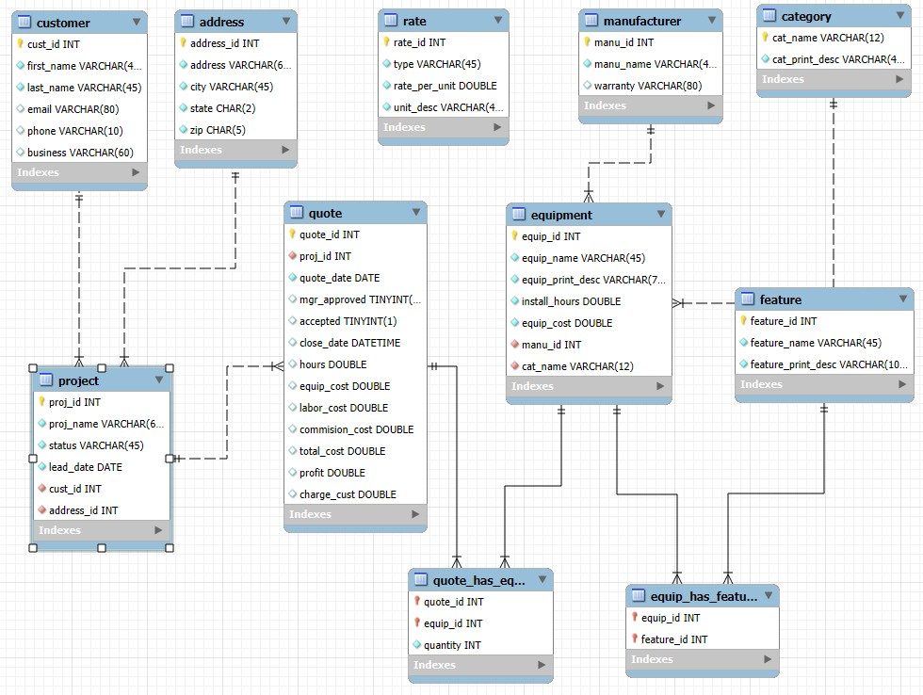
ERD

